Slide 1
Lessons Learned/ Experience Gained
IHO – NIPPON FOUNDATION
ALUMNI SEMINAR
Commander (H) PAPS Perera, BSc. (DS), MBS, MSc. (Hydrography), MSc. (GIS & RS)

Slide 2
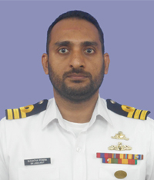
Self introduction
IHO – NIPPON FOUNDATION
ALUMNI SEMINAR
Name | PAPS Perera
Alumni year | 2017
Country | Sri Lanka
Organization | Sri Lanka Navy Hydrographic Service
Position/Job title | Director Marine GIS & Cartography
Current job description | Responsible for production of ENCs, Paper Charts, Defence Charts and other Thematic Maps

Slide 3
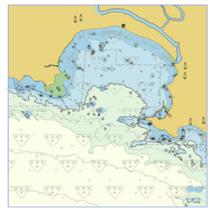
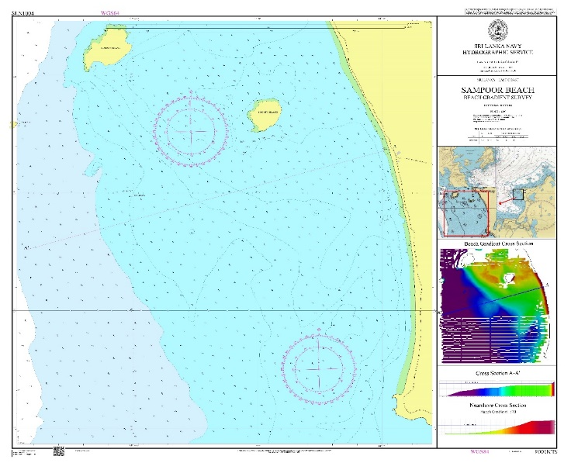
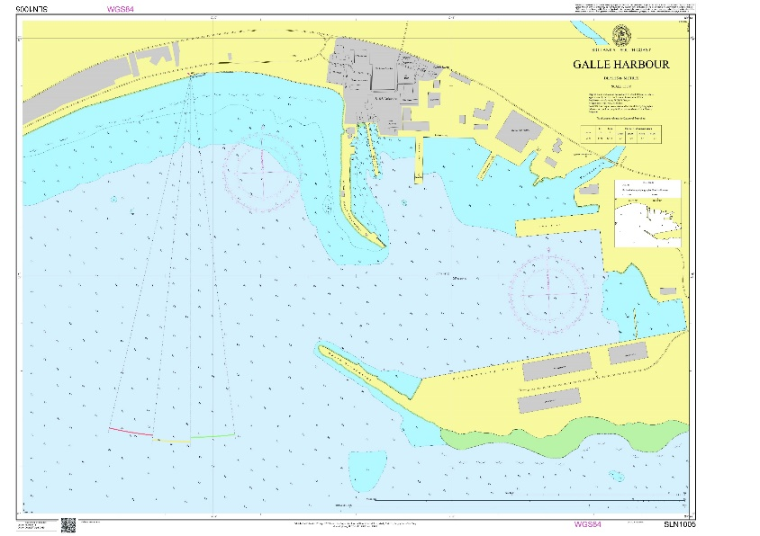
My career path and projects / Achievements
IHO – NIPPON FOUNDATION
ALUMNI SEMINAR
CAT ‘B’ & CAT ‘A’ Hydrography - Hydrographic Surveyor
CAT ‘B’ Cartography -
Senior Manager Marine GIS & Cartography,
Director Marine GIS & Cartography

Slide 4
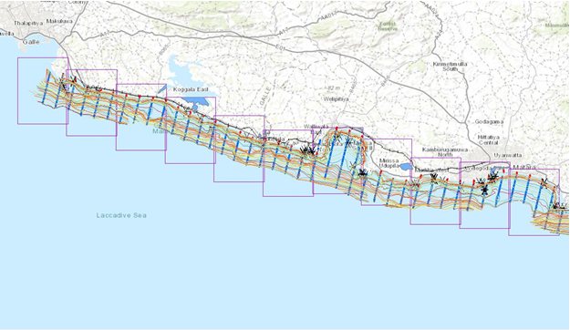
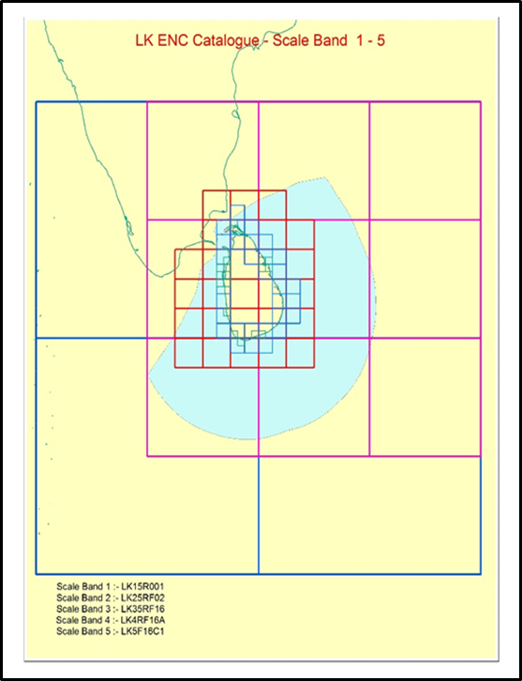
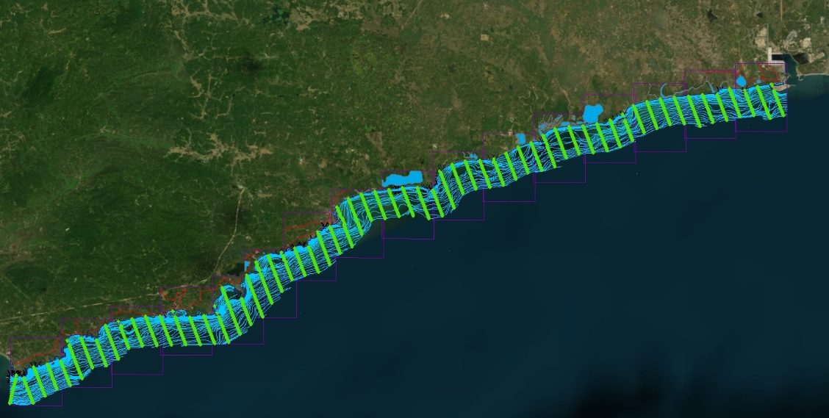
My career path and projects / Achievements
IHO – NIPPON FOUNDATION
ALUMNI SEMINAR

Slide 5
Lessons learned from CHART Course
IHO – NIPPON FOUNDATION
ALUMNI SEMINAR
Production of ENCs and Paper Charts
Professional knowledge on Marine Cartography
How to assess Hydrographic data
Preparation of N to M
Insights in developing national policies to meet SOLAS obligations

Slide 6
Suggestion for the future
IHO – NIPPON FOUNDATION
ALUMNI SEMINAR
To continue the chart project help building the capacities of hydrographic offices across the world.
Educate new candidates on all aspects of S-100 enabling to prepare for the future ENC production.
Inclusion of S-63 ENC encryption procedures in the syllabus.

